Slide 1
Time Series Data- Part 2 Aggregations in Action
#ConferenceHashTag
Bryan Reinero
Consulting Engineer, MongoDB

Slide 2
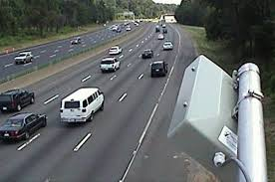
Real Time Traffic Data Project
Our network of 16,000 speed sensors report data every minute.
Notes:
Reports (group, summing, averaging)
Analytics(incremental reporting, rollups)
Analysis (trends, segmentation, anomalies)
Analytics (regression, forecasting, filtering)
Warehousing (long term storage and simplified querying)

Slide 3
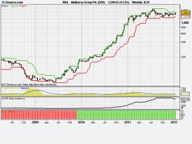
What we want from our data
Charting and Trending

Slide 4
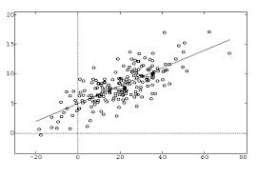
What we want from our data
Historical & Predictive Analysis

Slide 5
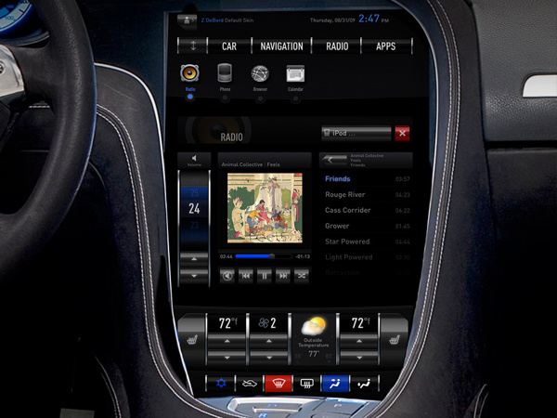
What we want from our data
Real Time Traffic Dashboard

Slide 6
Document Structure
{ _id: ObjectId("5382ccdd58db8b81730344e2"),
linkId: 900006,
date: ISODate("2014-03-12T17:00:00Z"),
data: [
{ speed: NaN, time: NaN },
{ speed: NaN, time: NaN },
{ speed: NaN, time: NaN },
...
],
conditions: {
status: "Snow / Ice Conditions",
pavement: "Icy Spots",
weather: "Light Snow"
}
}
Notes:
Compound unique index on linkId & Interval
update field used to identify new documents for aggregation

Slide 7
Sample Document Structure
{ _id: ObjectId("5382ccdd58db8b81730344e2"),
linkId: 900006,
date: ISODate("2014-03-12T17:00:00Z"),
data: [
{ speed: NaN, time: NaN },
{ speed: NaN, time: NaN },
{ speed: NaN, time: NaN },
...
],
conditions: {
status: "Snow / Ice Conditions",
pavement: "Icy Spots",
weather: "Light Snow"
}
}
Compound, unique
Index identifies the
Individual document
Notes:
Compound unique index on linkId & Interval
update field used to identify new documents for aggregation

Slide 8
Sample Document Structure
{ _id: “900006:14031217”,
data: [
{ speed: NaN, time: NaN },
{ speed: NaN, time: NaN },
{ speed: NaN, time: NaN },
...
],
conditions: {
status: "Snow / Ice Conditions",
pavement: "Icy Spots",
weather: "Light Snow"
}
}
Saves an extra index
Notes:
Compound unique index on linkId & Interval
update field used to identify new documents for aggregation

Slide 9
Sample Document Structure
{ _id: “900006:14031217”,
data: [
{ speed: NaN, time: NaN },
{ speed: NaN, time: NaN },
{ speed: NaN, time: NaN },
...
],
conditions: {
status: "Snow / Ice Conditions",
pavement: "Icy Spots",
weather: "Light Snow"
}
}
Range queries:
/^900006:1403/
Regex must be
left-anchored &
case-sensitive
Notes:
Compound unique index on linkId & Interval
update field used to identify new documents for aggregation

Slide 10
Sample Document Structure
{ _id: “900006:140312”,
data: [
{ speed: NaN, time: NaN },
{ speed: NaN, time: NaN },
{ speed: NaN, time: NaN },
...
],
conditions: {
status: "Snow / Ice Conditions",
pavement: "Icy Spots",
weather: "Light Snow"
}
}
Pre-allocated,
60 element array of
per-minute data
Notes:
Compound unique index on linkId & Interval
update field used to identify new documents for aggregation

Slide 11
Charts
db.linkData.find( { _id : /^20484097:2014031/ } )
Notes:
Priority
Floating point number between 0..1000
Highest member that is up to date wins
Up to date == within 10 seconds of primary
If a higher priority member catches up, it will force election and win
Slave Delay
Lags behind master by configurable time delay
Automatically hidden from clients
Protects against operator errors
Fat fingering
Application corrupts data

Slide 12
Rollups
{ _id: "20484097:20140204",
hours: [
{ speed: { sum: 1889, count: 60 }
time: { sum: 20562, count: 60 },
conditions: {
status: "Snow / Ice Conditions",
pavement: "Icy Spots",
weather: "Light Snow"
}
},
{ speed: {m: 1892, count: 60 },
time: {sum: 20442, count: 60 },
conditions: {
status: "Snow / Ice Conditions",
pavement: "Slush",
weather: "Light Snow"
}
}
]}
Notes:
Compound unique index on linkId & Interval
update field used to identify new documents for aggregation

Slide 13
Document retention
2 days
Doc per hour
2 months
Doc per day
1year
Doc per Month

Slide 14
Analysis with The Aggregation Framework

Slide 15
Pipelining operations
Piping command line operations
grep
|
sort
|
uniq

Slide 16
Pipelining operations
Piping aggregation operations
$match
|
$group
|
$sort
Stream of documents
Result documents

Slide 17
What is the average speed for a given road segment?
> db.linkData.aggregate(
{ $match: { ”_id" : /^20484097:/ } },
{ $project: { "data.speed": 1 } } ,
{ $unwind: "$data"},
{ $group: { _id: “”, ave: { $avg: "$data.speed"} } }
);
{ "_id" : 20484097, "ave" : 47.067650676506766 }
Notes:
Priority
Floating point number between 0..1000
Highest member that is up to date wins
Up to date == within 10 seconds of primary
If a higher priority member catches up, it will force election and win
Slave Delay
Lags behind master by configurable time delay
Automatically hidden from clients
Protects against operator errors
Fat fingering
Application corrupts data

Slide 18
What is the average speed for a given road segment?
> db.linkData.aggregate(
{ $match: { ”_id" : /^20484097:/ } },
{ $project: { "data.speed": 1, linkId: 1 } } ,
{ $unwind: "$data"},
{ $group: { _id: "$linkId", ave: { $avg: "$data.speed"} } }
);
{ "_id" : 20484097, "ave" : 47.067650676506766 }
Select documents on the target segment
Notes:
Priority
Floating point number between 0..1000
Highest member that is up to date wins
Up to date == within 10 seconds of primary
If a higher priority member catches up, it will force election and win
Slave Delay
Lags behind master by configurable time delay
Automatically hidden from clients
Protects against operator errors
Fat fingering
Application corrupts data

Slide 19
What is the average speed for a given road segment?
> db.linkData.aggregate(
{ $match: { ”_id" : /^20484097:/ } },
{ $project: { "data.speed": 1, linkId: 1 } } ,
{ $unwind: "$data"},
{ $group: { _id: "$linkId", ave: { $avg: "$data.speed"} } }
);
{ "_id" : 20484097, "ave" : 47.067650676506766 }
Keep only the fields we really need
Notes:
Priority
Floating point number between 0..1000
Highest member that is up to date wins
Up to date == within 10 seconds of primary
If a higher priority member catches up, it will force election and win
Slave Delay
Lags behind master by configurable time delay
Automatically hidden from clients
Protects against operator errors
Fat fingering
Application corrupts data

Slide 20
What is the average speed for a given road segment?
> db.linkData.aggregate(
{ $match: { ”_id" : /^20484097:/ } },
{ $project: { "data.speed": 1, linkId: 1 } } ,
{ $unwind: "$data"},
{ $group: { _id: "$linkId", ave: { $avg: "$data.speed"} } }
);
{ "_id" : 20484097, "ave" : 47.067650676506766 }
Loop over the array of data points
Notes:
Priority
Floating point number between 0..1000
Highest member that is up to date wins
Up to date == within 10 seconds of primary
If a higher priority member catches up, it will force election and win
Slave Delay
Lags behind master by configurable time delay
Automatically hidden from clients
Protects against operator errors
Fat fingering
Application corrupts data

Slide 21
What is the average speed for a given road segment?
> db.linkData.aggregate(
{ $match: { ”_id" : /^20484097:/ } },
{ $project: { "data.speed": 1, linkId: 1 } } ,
{ $unwind: "$data"},
{ $group: { _id: "$linkId", ave: { $avg: "$data.speed"} } }
);
{ "_id" : 20484097, "ave" : 47.067650676506766 }
Use the handy $avg operator
Notes:
Priority
Floating point number between 0..1000
Highest member that is up to date wins
Up to date == within 10 seconds of primary
If a higher priority member catches up, it will force election and win
Slave Delay
Lags behind master by configurable time delay
Automatically hidden from clients
Protects against operator errors
Fat fingering
Application corrupts data

Slide 22
More Sophisticated Pipelines: average speed with variance
{ "$project" : {
mean: "$meanSpd",
spdDiffSqrd : {
"$map" : {
"input": {
"$map" : {
"input" : "$speeds",
"as" : "samp",
"in" : { "$subtract" : [ "$$samp", "$meanSpd" ] }
}
},
as: "df", in: { $multiply: [ "$$df", "$$df" ] }
} } } },
{ $unwind: "$spdDiffSqrd" },
{ $group: { _id: mean: "$mean", variance: { $avg: "$spdDiffSqrd" } } }
Notes:
Priority
Floating point number between 0..1000
Highest member that is up to date wins
Up to date == within 10 seconds of primary
If a higher priority member catches up, it will force election and win
Slave Delay
Lags behind master by configurable time delay
Automatically hidden from clients
Protects against operator errors
Fat fingering
Application corrupts data

Slide 23
Historic Analysis
How does weather and road conditions affect traffic?
The Ask: what are the average speeds per weather, status and pavement

Slide 24
MapReduce
function map() {
for( var i = 0; i < this.data.length; i++ ) {
emit (
this.conditions.weather,
{ speed : this.data[i].speed }
);
emit (
this.conditions.status,
{ speed : this.data[i].speed }
);
emit (
this.conditions.pavement,
{ speed : this.data[i].speed }
);
} }

Slide 25
MapReduce
function map() {
for( var i = 0; i < this.data.length; i++ ) {
emit (
this.conditions.weather,
{ speed : this.data[i].speed }
);
emit (
this.conditions.status,
{ speed : this.data[i].speed }
);
emit (
this.conditions.pavement,
{ speed : this.data[i].speed }
);
} }
“Snow”, 34

Slide 26
MapReduce
function map() {
for( var i = 0; i < this.data.length; i++ ) {
emit (
this.conditions.weather,
{ speed : this.data[i].speed }
);
emit (
this.conditions.status,
{ speed : this.data[i].speed }
);
emit (
this.conditions.pavement,
{ speed : this.data[i].speed }
);
} }
“Icy spots”, 34

Slide 27
MapReduce
function map() {
for( var i = 0; i < this.data.length; i++ ) {
emit (
this.conditions.weather,
{ speed : this.data[i].speed }
);
emit (
this.conditions.status,
{ speed : this.data[i].speed }
);
emit (
this.conditions.pavement,
{ speed : this.data[i].speed }
);
} }
“Delays”, 34

Slide 28
MapReduce

Slide 29
MapReduce
Weather: “Rain”, speed: 44

Slide 30
MapReduce
Weather: “Rain”, speed: 39

Slide 31
MapReduce
Weather: “Rain”, speed: 46

Slide 32
MapReduce
function reduce ( key, values ) {
var result = { count : 1, speedSum : 0 };
values.forEach( function( v ){
result.speedSum += v.speed;
result.count++;
});
return result;
}

Slide 33
MapReduce
function reduce ( key, values ) {
var result = { count : 1, speedSum : 0 };
values.forEach( function( v ){
result.speedSum += v.speed;
result.count++;
});
return result;
}

Slide 34
Results
results: [
{
"_id" : "Generally Clear and Dry Conditions",
"value" : {
"count" : 902,
"speedSum" : 45100
}
},
{
"_id" : "Icy Spots",
"value" : {
"count" : 242,
"speedSum" : 9438
}
},
{
"_id" : "Light Snow",
"value" : {
"count" : 122,
"speedSum" : 7686
}
},
{
"_id" : "No Report",
"value" : {
"count" : 782,
"speedSum" : NaN
}
}

Slide 35

Processing Large Data Sets
Need to break data into smaller pieces
Process data across multiple nodes
Hadoop
Hadoop
Hadoop
Hadoop
Hadoop
Hadoop
Hadoop
Hadoop
Hadoop
Hadoop

Slide 36

Benefits of the Hadoop Connector
Increased parallelism
Access to analytics libraries
Separation of concerns
Integrates with existing tool chains

Slide 37
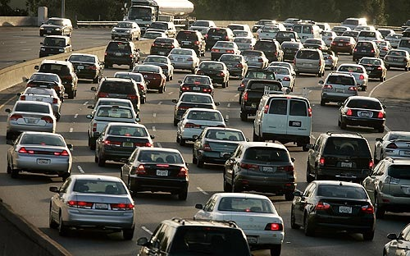
Real-time Dashboard
Drivers will be accessing the data via web, mobile devices, and navigation systems
We need to provide current average speed, travel time and weather per road segment

Slide 38
Current Real-Time Conditions
{ _id : “I-87:10656”,
description : "NYS Thruway Harriman Section Exits 14A - 16",
update : ISODate(“2013-10-10T23:06:37.000Z”),
speeds : [ 52, 49, 45, 51, ... ],
times : [ 237, 224, 246, 233,... ],
pavement: "Wet Spots",
status: "Wet Conditions",
weather: "Light Rain”,
averageSpeed: 50.23,
averageTime: 234,
maxSafeSpeed: 53.1,
location" : {
"type" : "LineString",
"coordinates" : [
[ -74.056, 41.098 ],
[ -74.077, 41.104 ] }
}
Last ten minutes of speeds and times
Notes:
Priority
Floating point number between 0..1000
Highest member that is up to date wins
Up to date == within 10 seconds of primary
If a higher priority member catches up, it will force election and win
Slave Delay
Lags behind master by configurable time delay
Automatically hidden from clients
Protects against operator errors
Fat fingering
Application corrupts data

Slide 39
Current Real-Time Conditions
{ _id : “I-87:10656”,
description : "NYS Thruway Harriman Section Exits 14A - 16",
update : ISODate(“2013-10-10T23:06:37.000Z”),
speeds : [ 52, 49, 45, 51, ... ],
times : [ 237, 224, 246, 233,... ],
pavement: "Wet Spots",
status: "Wet Conditions",
weather: "Light Rain”,
averageSpeed: 50.23,
averageTime: 234,
maxSafeSpeed: 53.1,
location" : {
"type" : "LineString",
"coordinates" : [
[ -74.056, 41.098 ],
[ -74.077, 41.104 ] }
}
Pre-aggregated metrics
Notes:
Priority
Floating point number between 0..1000
Highest member that is up to date wins
Up to date == within 10 seconds of primary
If a higher priority member catches up, it will force election and win
Slave Delay
Lags behind master by configurable time delay
Automatically hidden from clients
Protects against operator errors
Fat fingering
Application corrupts data

Slide 40
Current Real-Time Conditions
{ _id : “I-87:10656”,
description : "NYS Thruway Harriman Section Exits 14A - 16",
update : ISODate(“2013-10-10T23:06:37.000Z”),
speeds : [ 52, 49, 45, 51, ... ],
times : [ 237, 224, 246, 233,... ],
pavement: "Wet Spots",
status: "Wet Conditions",
weather: "Light Rain”,
averageSpeed: 50.23,
averageTime: 234,
maxSafeSpeed: 53.1,
location" : {
"type" : "LineString",
"coordinates" : [
[ -74.056, 41.098 ],
[ -74.077, 41.104 ] }
}
Geo-spatially indexed road segment
Notes:
Priority
Floating point number between 0..1000
Highest member that is up to date wins
Up to date == within 10 seconds of primary
If a higher priority member catches up, it will force election and win
Slave Delay
Lags behind master by configurable time delay
Automatically hidden from clients
Protects against operator errors
Fat fingering
Application corrupts data

Slide 41
Maintaining the current conditions
db.linksAvg.update(
{"_id" : linkId},
{ "$set" : {"update " : date},
"$push" : {
"times" : { "$each" : [ time ], "$slice" : -10 },
"speeds" : {"$each" : [ speed ], "$slice" : -10}
}
})
Each update pops the last element off the array and pushes the new value
Notes:
Priority
Floating point number between 0..1000
Highest member that is up to date wins
Up to date == within 10 seconds of primary
If a higher priority member catches up, it will force election and win
Slave Delay
Lags behind master by configurable time delay
Automatically hidden from clients
Protects against operator errors
Fat fingering
Application corrupts data

Slide 42
Putting it all together

Slide 43
Patterns common to time series data:
You need to store and manage an incoming stream of data samples
You need to compute derivative data sets based on these samples
You need low latency access to up-to-date data
Notes:
Reports (group, summing, averaging)
Analytics(incremental reporting, rollups)
Analysis (trends, segmentation, anomalies)
Analytics (regression, forecasting, filtering)
Warehousing (long term storage and simplified querying)

Slide 44
Patterns common to time series data:
You need to store and manage an incoming stream of data samples
You need to compute derivative data sets based on these samples
You need low latency access to up-to-date data
Introducing The High Volume Data Feed
Notes:
Reports (group, summing, averaging)
Analytics(incremental reporting, rollups)
Analysis (trends, segmentation, anomalies)
Analytics (regression, forecasting, filtering)
Warehousing (long term storage and simplified querying)

Slide 45
HVDF: Reference Implementation
Screech -- High Volume Data Feed engine
Incoming Sample Stream
REST Service API
Processor Plugins
Channel Data Storage
Inline
Raw Channel Data
Aggregated Rollup T1
Aggregated Rollup T2
POST /feed/channel/data
Batch
Stream
Real-time Queries
Query Processor
Streaming spout
GET /feed/channeldata?time=XXX&range=YYY
Custom Stream Processing Logic
Notes:
Reports (group, summing, averaging)
Analytics(incremental reporting, rollups)
Analysis (trends, segmentation, anomalies)
Analytics (regression, forecasting, filtering)
Warehousing (long term storage and simplified querying)

Slide 46

HVDF: https://github.com/10gen-labs/hvdf
Hadoop Connector: https://github.com/mongodb/mongo-hadoop

Slide 47
Thank You
#MongoDBWorld
Bryan Reinero
Consulting Engineer, MongoDB Inc.

